Slide 1
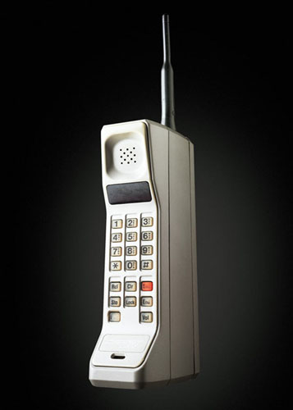
History Of Mobile
The first commercially available mobile phone on 1983.
The motorola DynaTac 8000X in 1983 ,13 X 1.75 X 3.5 inches, weight 2.5 pound.
Retail price was $3,995 plus.
Talk for a little more then half an hour.

Slide 2
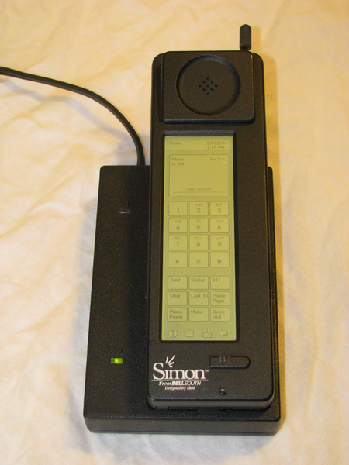
First Smart Phone
IBM Simon which was a joint venture between IBM and BellSouth is considered as the first Smartphone in this world.
Designed in 1992, launched to the public in 1993
Sold by BellSouth.
It combined the features of a mobile phone, a pager, a PDA, and a fax machine.

Slide 3
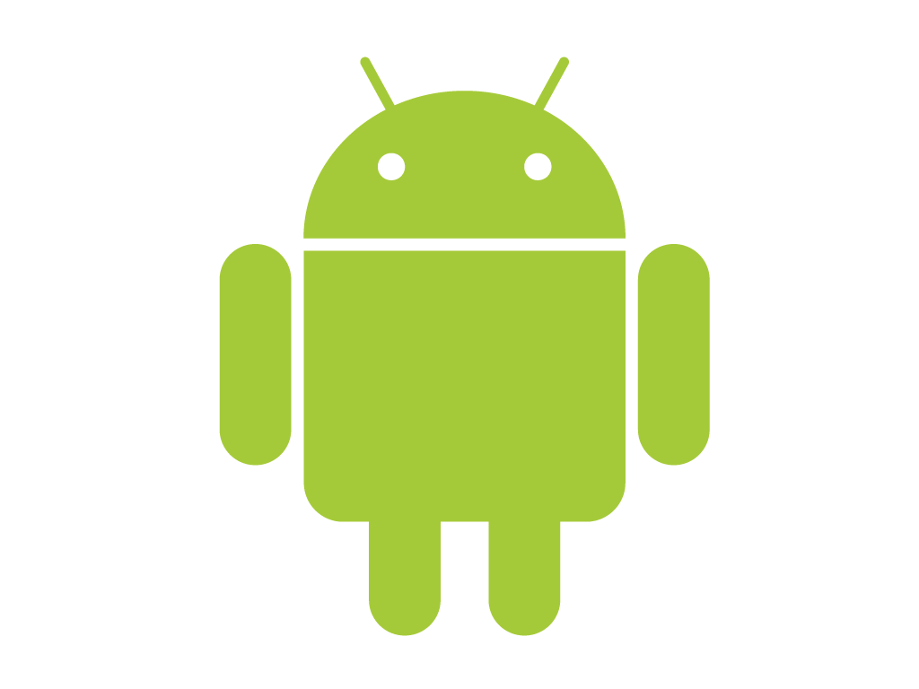
History Of Android
Android, Inc (incredible). was founded in Palo Alto, California, United States in October, 2003 by
- Andy Rubin
- Rich Miner
- Nick Sears
- & Chris White
Acquisition by Google
Google acquired Android Inc. in August 2005, making Android Inc. a wholly owned subsidiary of Google Inc

Slide 4
Continue…
In late 2007, a group of industry leaders came together around the Android Platform to form the Open Handset Alliance (http://www.openhandsetalliance.com).
The Android SDK was first issued as an “early look” release in November 2007.
In September 2008 T-Mobile announced the availability of the T-Mobile G1, the first smart phone based on the Android Platform.
A few days after that, Google announced the availability of Android SDK Release “Candidate 1.0. “
In October 2008, Google made the source code of the Android Platform available under Apache’s open source license.

Slide 5
Open Handset Alliance (OHA)
The Open Handset Alliance (OHA) is a business alliance of 83 firms to
develop open standards for mobile devices.
Devoted to advancing open standards for mobile devices
Develop technologies that will significantly lower the cost of developing and distributing mobile devices and services
Member firms include
  Google
  HTC
  Sony Dell
  Intel Motorola
  Qualcomm
  Texas Instruments
  Samsung
  LG
  T-Mobile
  Wind River Systems and many more…

Slide 6
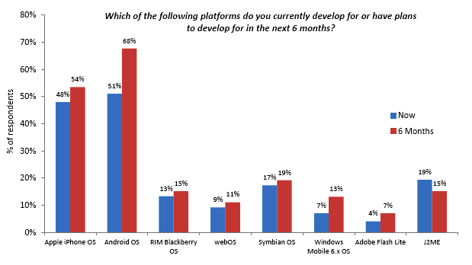
Market Of Android

Slide 7
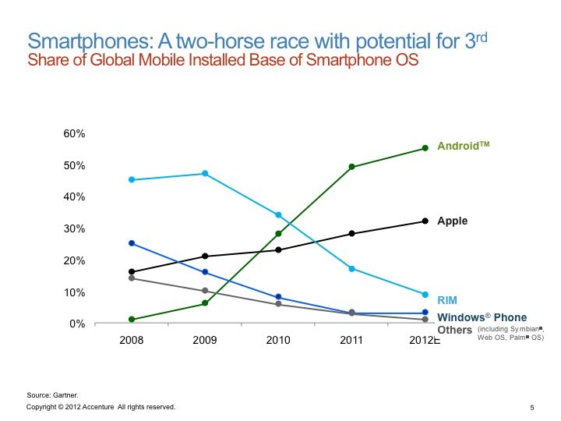

Slide 8
Advantages Of Android Platform
Free and Open Source
  Android is an open source platform. Neither developers nor handset manufacturers pay license fees to develop for the platform.
  The Android framework is distributed under the Apache Software License (ASL/Apache2)
  Which allows for the distribution of both open- and closed-source derivations of the source code.

Slide 9
Continue…
Familiar and Inexpensive Development Tools
  Unlike some proprietary platforms that require developer registration fees
  vetting (process of analyzing or financial instruments before committing money)
  expensive compilers
  Here, “no upfront costs” to developing Android applications.

Slide 10
Continue…
  Freely Available Software Development Kit
  The Android SDK and tools are freely available.
  Developers can download the Android SDK from the Android website after agreeing to the terms of the Android Software Development Kit License Agreement.

Slide 11
Continue…
Familiar Language, Familiar Development Environments
  Many developers choose the popular and freely available Eclipse IDE to design and develop Android applications.
  Eclipse is the most popular IDE for Android development, and there is an Android plug-in available for facilitating Android development.
  Android applications can be developed on the following operating systems:
  1) Windows XP (32-bit) or Vista (32-bit or 64-bit)
  2) Mac OS X 10.5.8 or later (x86 only)
  3) Linux (tested on Linux Ubuntu 8.04 LTS, Hardy Heron)

Slide 12
Continue…
No Extra Learning for Developers
  Android applications are written in a well-respected programming language: Java.
  The Android application framework includes traditional programming constructs, such as
  threads and processes and specially designed data structures to encapsulate objects commonly used in mobile applications
  Developers can rely on familiar class libraries, such as
  java.net and java.text.

Slide 13
Continue…
Enabling Development of Powerful Applications
  On the Android platform, there is no distinction between native and third-party applications,
  All Android applications use the same libraries.
  Android applications have unlimited access to the underlying hardware, allowing developers to write much more powerful applications

Slide 14
Continue…
Rich, Secure Application Integration
  One of the Android platform’s most compelling and innovative features is well-designed application integration
  Android provides all the tools necessary to build a better “integration”
  By allowing developers to write applications that seamlessly huge core functionality such as web browsing, mapping, contact management, and messaging.
  Applications can also become content providers and share their data among each other in a secure fashion.

Slide 15
Continue…
No Costly For Publication
  Android applications have none of the costly and time-intensive testing and certification
  Like , Programs required by other platforms such as Symbian.

Slide 16
Continue…
A “Free Market” for Applications
  Android developers are free to choose any kind of revenue model they want.
  like , freeware, shareware, or trial-ware applications and paid applications.
  With Android, developers can write and successfully publish any kind of application they want

Slide 17
Android Development Tools
The Android SDK includes several tools and utilities to help you create, test, and debug your projects.
Eclipse IDE, mainly there are
1) The Android SDK and Virtual Device Manager
2) DDMS : Dalvik Debug Monitor Server (monitoring)
3) The Android Emulator (run with in AVD)
4) Android Asset Packaging Tool (AAPT) (*.apk)

Slide 18
5) Android Debug Bridge (ADB) (A client-server application)
6) SQLite3
7) Traceview (trace logs)
8) MkSDCard (external storage card.)
9) Dx (Converts Java .class bytecode into *.dex )
10) activityCreator
11) layoutOpt (layout resources optimization)

